Slide 1

SWE 425: Telecommunication Engineering
Md. Habibur Rahman
Lecturer, Department of Software Engineering

Slide 2
Cellular Concept

Slide 3
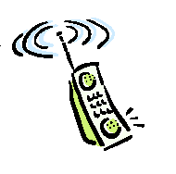
Interference and System Capacity
Sources of interference
another mobile in the same cell
a call in progress in the neighboring cell
other base stations operating in the same frequency band
Non cellular system leaks energy into the cellular frequency band
Two major cellular interference
co-channel interference
adjacent channel interference

Slide 4
Co-channel Interference and System Capacity
Frequency reuse - there are several cells that use the same set of frequencies
co-channel cells
co-channel interference
To reduce co-channel interference, co-channel cell must be separated by a minimum distance.
When the size of the cell is approximately the same
co-channel interference is independent of the transmitted power
co-channel interference is a function of
R: Radius of the cell
D: distance to the center of the nearest co-channel cell
Increasing the ratio Q=D/R, the interference is reduced.
Q is called the co-channel reuse ratio

Slide 5
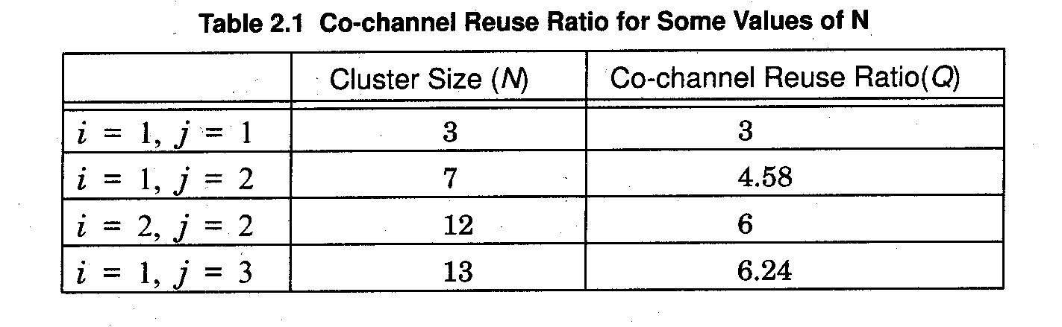
For a hexagonal geometry
A small value of Q provides large capacity
A large value of Q improves the transmission quality - smaller level of co-channel interference
A tradeoff must be made between these two objectives

Slide 6
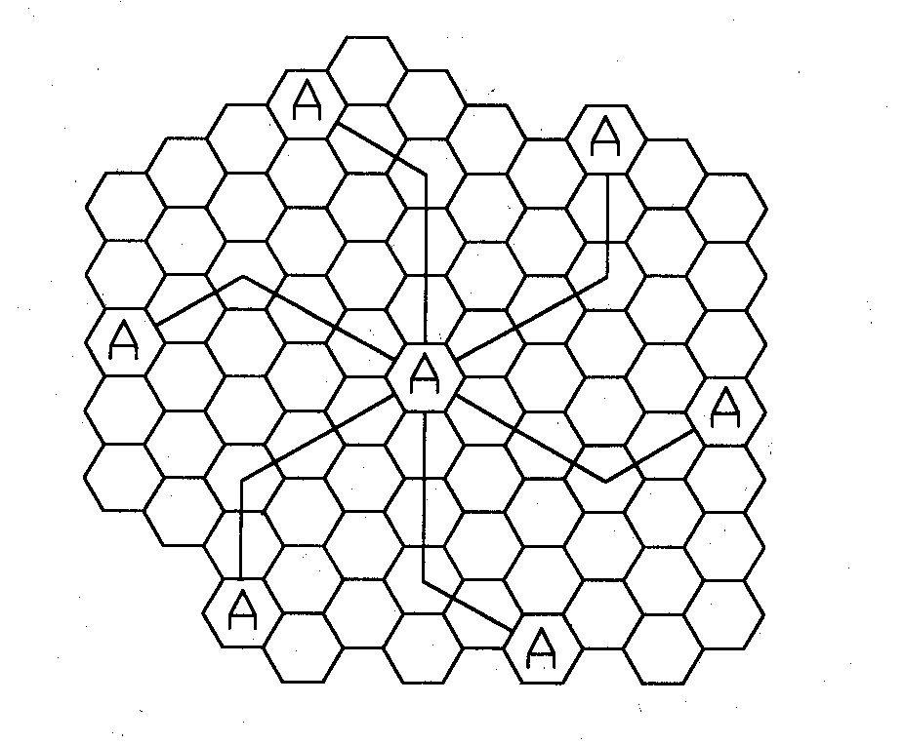
Consider only the first layer of interfering cells
n = path loss exponent
S/I = Signal to Interference Ratio
Example: AMPS requires that SIR be greater than 18dB
N should be at least 6.49 for n=4.
Minimum cluster size is 7
Notes:
Path Loss exponent:
In the study of wireless communications, path loss can be represented by the path loss exponent, whose value is normally in the range of 2 to 4 (where 2 is for propagation in free space, 4 is for relatively lossy environments and for the case of full specular reflection from the earth surface—the so-called Flat Earth model). In some environments, such as buildings, stadiums and other indoor environments, the path loss exponent can reach values in the range of 4 to 6. On the other hand, a tunnel may act as a waveguide, resulting in a path loss exponent less than 2.
Path loss is usually expressed in dB. In its simplest form, the path loss can be calculated using the formula
L = 10n log 10 (d) + C
Where L is the path loss in decibels, n is the path loss exponent, d is the distance between the transmitter and the receiver, usually measured in meters, and C is a constant which accounts for system losses.

Slide 7
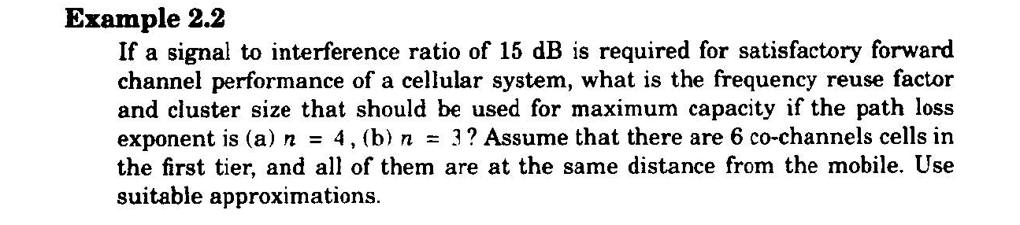
Problem:

Slide 8
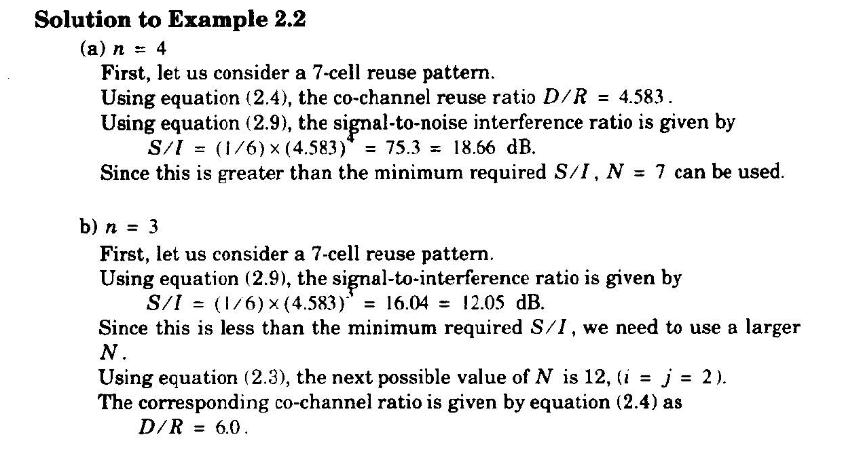
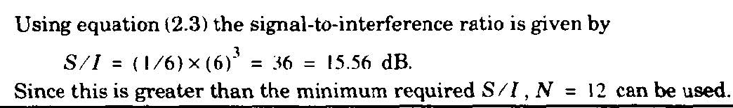
Solution:

Slide 9
Adjacent Channel Interference
Adjacent channel interference: interference from adjacent in frequency to the desired signal.
Imperfect receiver filters allow nearby frequencies to leak into the passband
Performance degrade seriously due to near-far effect.

Slide 10
Adjacent Channel Interference
Adjacent channel interference can be minimized through careful filtering and channel assignment.
Since each cell is given only a fraction of all available channels, a cell need not be assigned channels which are all adjacent in frequency.
By keeping the frequency separation between each channel in a given cell as large as possible, the adjacent channel interference may be reduced considerably.

Slide 11
Trunking:
The concept of trunking allows a large number of users to share the relatively small number of channels in a cell by providing access to each user, on demand, from a pool of available channels.

Slide 12
Grade of Service (GOS):
The Grade of Service (GOS) is a measure of the ability of a user to access a trunked system during the busiest hour.
It is a benchmark used to define the desired performance of a particular trunked system.
Grade of Service (GOS) is the likelihood that a call is blocked or delayed.

Slide 13
Trunking and Grade of Service:
Erlangs:
One Erlangs represents the amount of traffic density carried by a channel that is completely occupied.
Ex: A radio channel that is occupied for 30 minutes during an hour carries 0.5 Erlangs of traffic.
Each user generates a traffic intensity of Erlangs given by
H: average duration of a call.
: average number of call requests per unit time
For a system containing U users and an unspecified number of channels, the total offered traffic intensity A, is given by

Slide 14
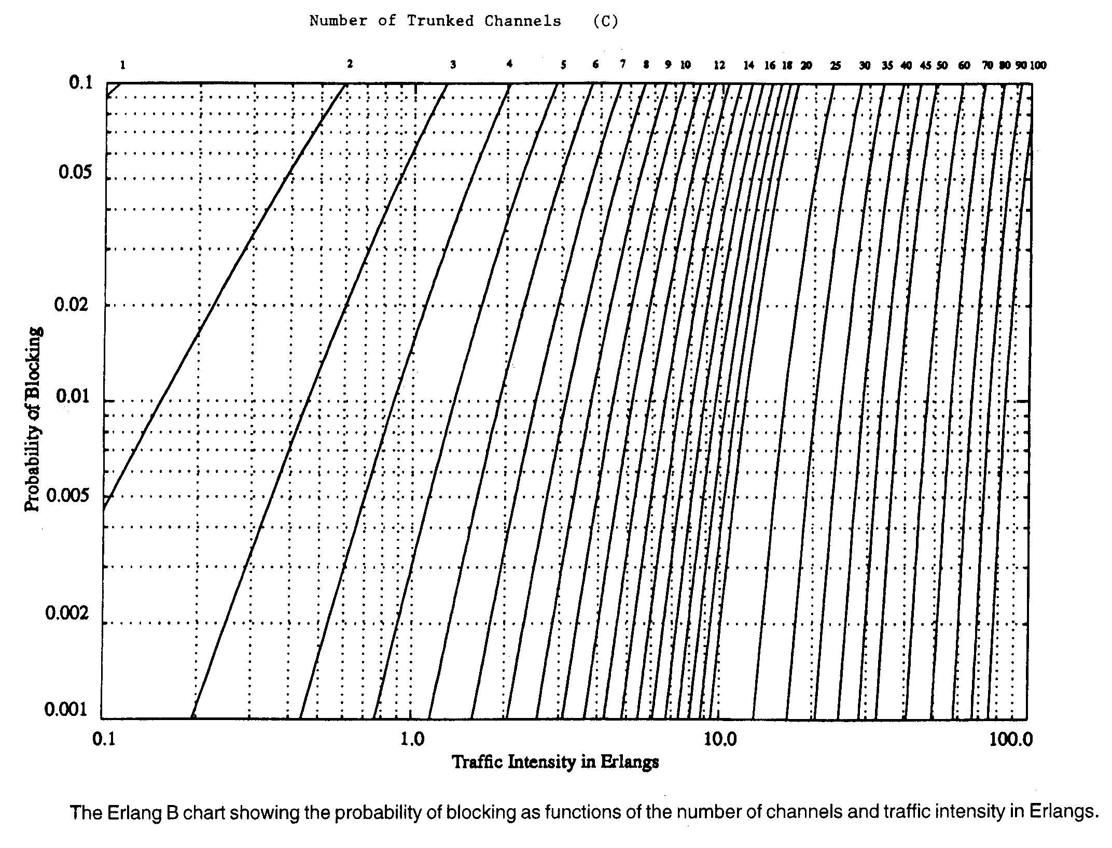
Erlang B Chart:

Slide 15
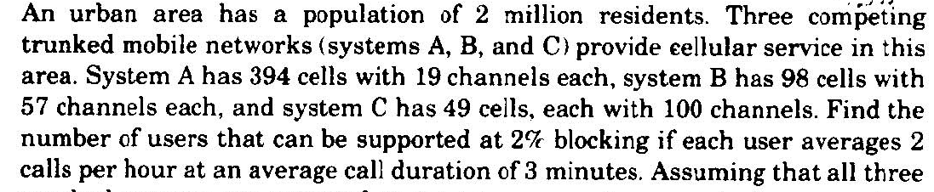
Problem:

Slide 16
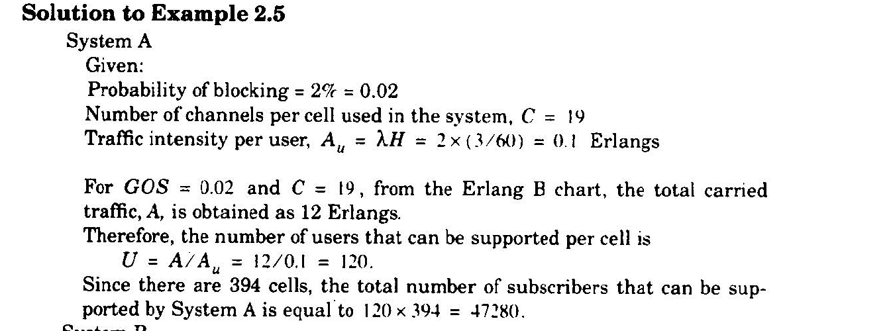
Solution:

Slide 17
Improving Capacity in Cellular Systems
Methods for improving capacity in cellular systems
Cell Splitting: subdividing a congested cell into smaller cells.
Sectoring: directional antennas to control the interference and frequency reuse.
Coverage zone : Distributing the coverage of a cell and extends the cell boundary to hard-to-reach place.

Slide 18
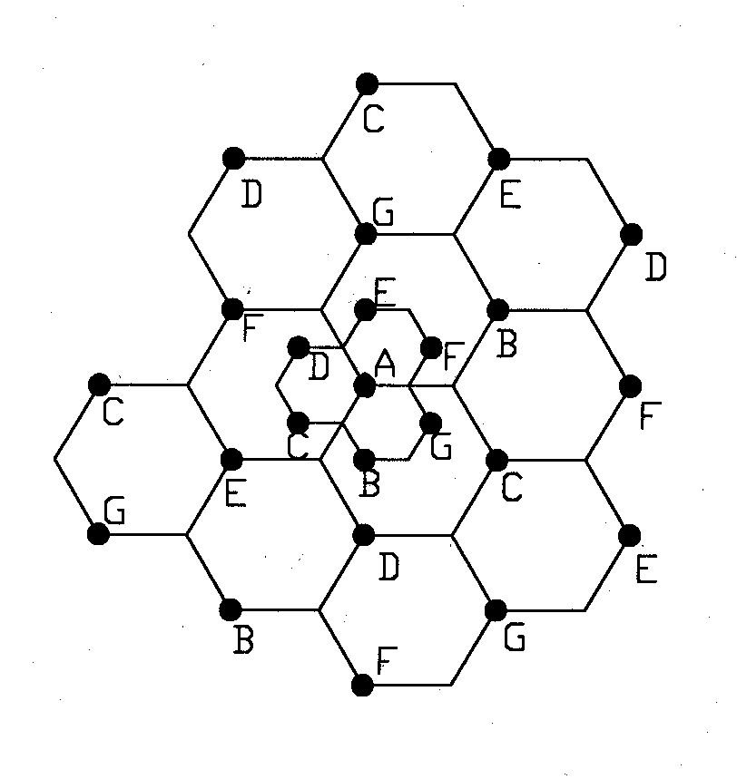
Cell Splitting
Split congested cell into smaller cells.
Preserve frequency reuse plan.
Reduce transmission power.
Reduce R to R/2
microcell

Slide 19
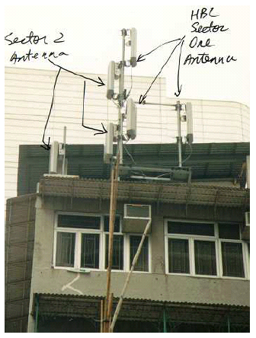
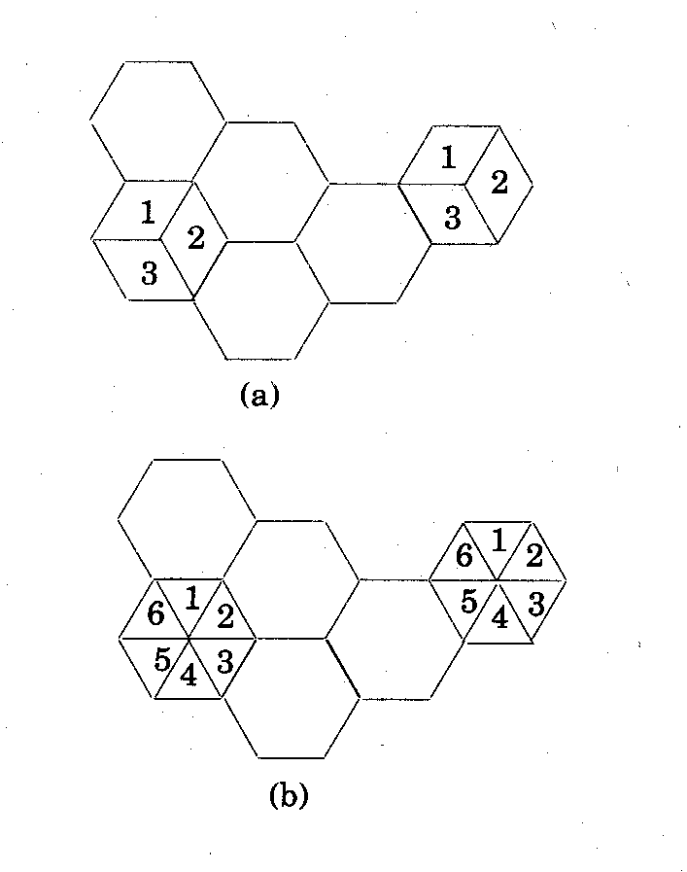
Sectoring
Decrease the co-channel interference and keep the cell radius R unchanged
Replacing single omni-directional antenna by several directional antennas
Radiating within a specified sector

Slide 20
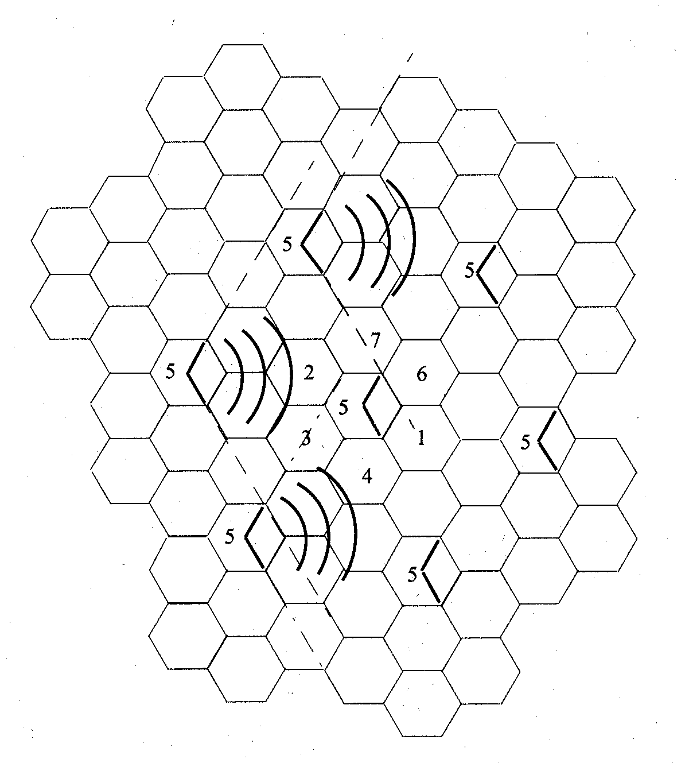
Interference Reduction
position of the mobile
interference cells

Slide 21
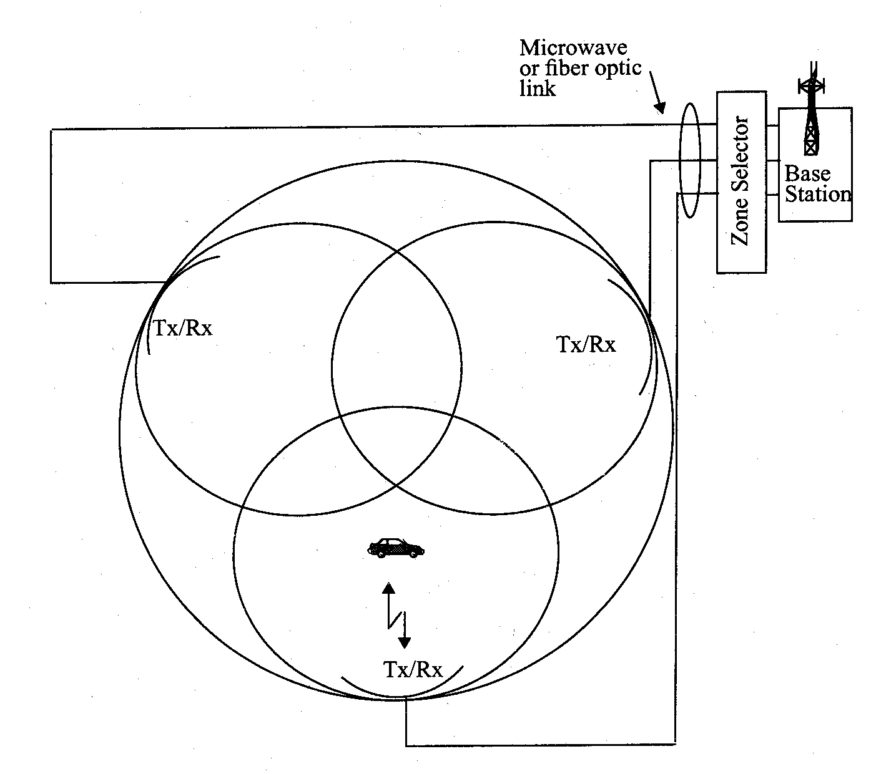
Microcell Zone Concept
Antennas are placed at the outer edges of the cell
Any channel may be assigned to any zone by the base station
Mobile is served by the zone with the strongest signal.
Handoff within a cell
No channel re-assignment
Switch the channel to a different zone site
Reduce interference
Low power transmitters are employed

Slide 22
The Switching System (SS):
Performs call processing and subscriber-related functions
The system includes the following functional units:
Mobile Services Switching Center (MSC)
Home Location Register (HLR)
Visitor Location Register (VLR)
Authentication Center (AUC)
Equipment Identity Register (EIR)

Slide 23
Mobile Services Switching Center (MSC)
The main element within the core network area of the overall GSM network architecture is the Mobile switching Services Centre (MSC).
It include registration, authentication, call location, inter-MSC handovers and call routing to a mobile subscriber.
It also provides an interface to the PSTN so that calls can be routed from the mobile network to a phone connected to a landline.

Slide 24
Home Location Register (HLR):
The HLR is the most important database
Storage and management of subscriptions
Permanent data includes
Subscriber’s service profile
Subscriber’s location information
Subscriber’s activity status
In this way, the GSM network is able to route calls to the relevant base station for the MS.
When a user switches on their phone, the phone registers with the network and from this it is possible to determine which BTS it communicates with.

Slide 25
Visitor Location Register (VLR):
The VLR contains temporary data about visiting (roaming) subscribers
It’s always integrated with the MSC
When a roamer enters the service area the VLR queries the appropriate HLR
If a roamer makes a call the VLR will already have the information it needs for call setup

Slide 26
Authentication Center (AuC):
The AuC verifies the identity of the user and ensures the confidentiality of each call
By providing authentication and encryption parameters for each call
Protects network operators from fraud
Assures a certain level of security for the content of each call

Slide 27
Equipment Identity Register (EIR):
The EIR is a database that includes info solely about the identity of mobile equipment
he EIR is the entity that decides whether a given mobile equipment may be allowed onto the network.
International Mobile Equipment Identity (IMEI) number prevents calls from stolen, unauthorized, or defective mobile stations
The AUC and the EIR can be implemented as stand-alone nodes or as a combined AUC/EIR node

Slide 28
The Base Station System (BSS)
The Base Station Subsystem (BSS) section of the GSM network architecture that is fundamentally associated with communicating with the mobiles on the network. It consists of two elements:
The Base Transceiver Station (BTS)
The Base Station Controller (BSC)

Slide 29
The Base Station System (BSS):
The Base Transceiver Station (BTS)
The BTS is the defining element for each cell.
Handles the radio interface to the mobile unit
Consists of tranceivers and cell antennas
A group of BTSs is controlled by a BSC

Slide 30
The Base Station System (BSS):
The Base Station Controller (BSC)
It controls a group of BTSs, and is often co-located with one of the BTSs in its group.
It manages the radio resources and controls items such as handover within the group of BTSs, allocates channels.
Provides all control functions and physical links between the MSC and the BTS
A group of BSCs is served by an MSC

Slide 31
Operation and Support Center (OSS):
It is used to control and monitor the overall GSM network and it is also used to control the traffic load of the BSS.
It is connected with all the equipment in the switching center and to the BSC
Provides centralized cost-effective support
Provides a network overview at any moment
Supports maintenance and operational activities for different organizations and groups

Slide 32
Thank You !!!
Any Questions ???

